Slide 1
Evaluating Large Language Models on Computer Science Education Using University Exam Questions
Edan Gabay, Yael Maoz, Jonathan Stahl, Naama Maoz, Abdo Amer, Orr Eilat, Adi Haviv, Hanoch Levy, Michal Kleinbort, Amir Rubinstein
Tel Aviv University

Slide 2
TL;DR
We built a dataset of theoretical CS questions from TAU exams to test LLMs, focusing on problems that require algorithmic and logical reasoning, not just coding.
We evaluated the performance of Claude 3.5 and GPT-4o on the dataset
LLMs scored ~55% - not enough to pass as a student ☹

Slide 3
About the team
This work was carried out by a team of undergrad students as part of a workshop in the Computer Science B.Sc. Program at TAU.
Supervised and lead by a teaching assistant pursuing her Ph.D. and three faculty members from the Computer Science Department
Edan Gabay, Yael Maoz, Jonathan Stahl, Naama Maoz, Abdo Amer, Orr Eilat, Adi Haviv, Hanoch Levy, Michal Kleinbort, Amir Rubinstein
Tel Aviv University

Slide 4
Data Structures Course
The first fundamental and theoretical course in a computer science degree
Serves as an introduction to algorithms
Core subject in computer science curricula worldwide
Covers fundamental ways to organize, store, and retrieve data
  Topics: arrays, linked lists, trees, hash tables, heaps, graphs, etc.

Slide 5
Why Evaluate LLMs on This Course?
They are widely used by students for homework and studying, both for coding and theoretical subjects
LLMs have been widely evaluated and demonstrated impressive capabilities in general knowledge and programming tasks
LLMs have barely been evaluated on complex algorithmic concepts and theoretical computer science questions

Slide 6
Our LLM Benchmark Dataset
A dataset of questions to be used to evaluate LLMs on university-level, theoretical questions about Data Structures curriculum.

Slide 7
Our LLM Benchmark Dataset
Based on 57 TAU exams (2001–2018)
883 questions
552 with verified answers
Covers multiple question types:
  Open questions
  Closed short-answer
  Multiple-choice with explanations
  Multiple-choice without explanations
Questions were translated to English using GPT 4o
Translations were manually evaluated

Slide 8
Our LLM Benchmark Dataset
Questions were translated to English using GPT 4o
Translations were manually evaluated

Slide 9
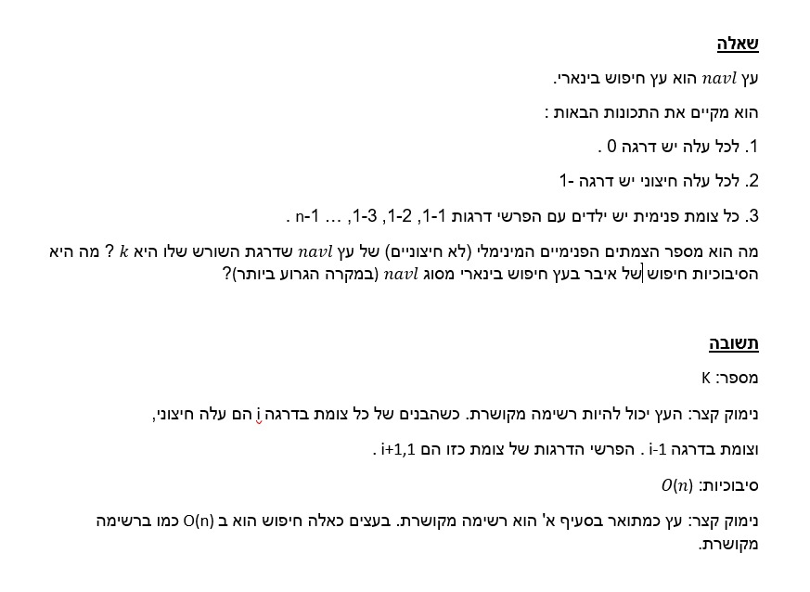
Example
Question

Slide 10
Evaluation
Models:
  GPT-4o (OpenAI)
    Default model for premium users
    Highest-performing available model for free users
  Claude 3.5 (Anthropic)
  Two additional small models

Slide 11
Evaluation
Questions:
  200 questions
  Closed short-answer & Multiple-choice
  Multiple topics: Various data structures, algorithms and analysis methods
Notes:
Complexity analysis, Recursive algorithms, Search trees, sorting algorithms, etc’

Slide 12
Evaluation
Questions:
Each question was queried:
  5 times per model as is
  5 times per model with Chain-of-Thought prompting
Why multiple times?
  Answers vary between runs, due to the probabilistic methods in which LLMs generate text
  LLM outputs don’t have a single fixed answers
  LLMs use sampling methods to pick the next word to be generated, sampling the next word from a probability distribution of possible words given the previous ones
    Even a small variation in the first few words can lead to a cascading effect, resulting in significantly different responses

Slide 13
Evaluation Results: Accuracy
Claude 3.5 | GPT-4o
62% | 57% | Multiple choice questions
49% | 47% | Closed-ended questions

Slide 14
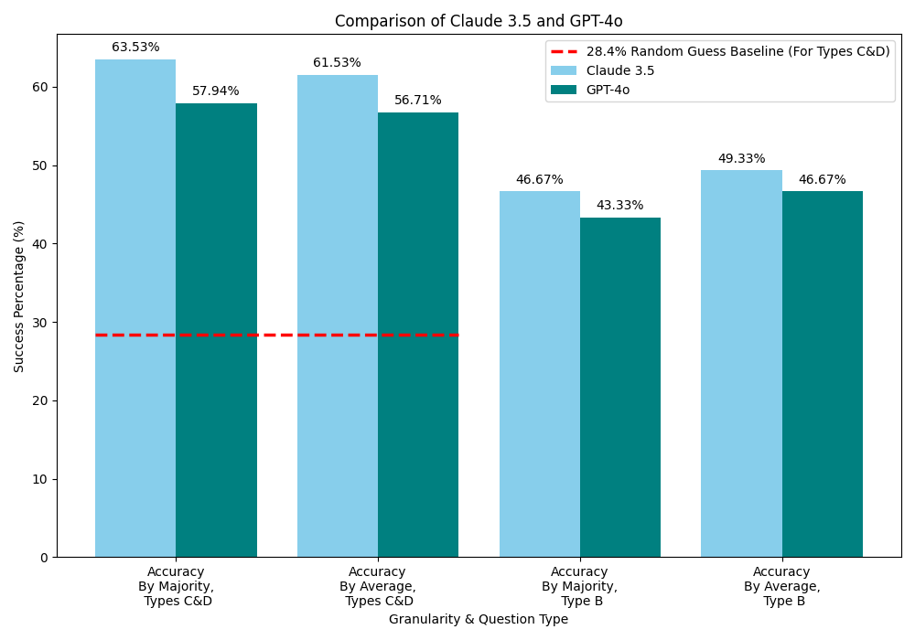
Evaluation Results: Accuracy

Slide 15
Evaluation Results: Prompt Engineering
Chain-of-Thought (CoT) prompting: instructs model to reason step-by-step
No consistent improvement from CoT
Possible reason: models already perform implicit reasoning

Slide 16
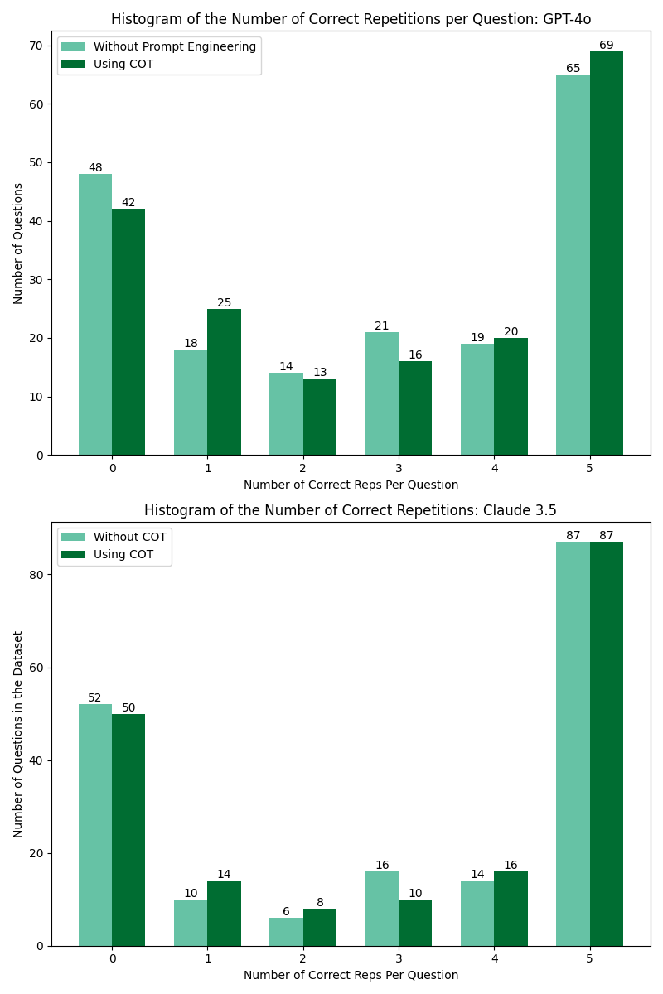
Evaluation Results: Prompt Engineering

Slide 17

Key Insights
Both models are well above random guessing, but there is still much room for improvement
Need to test new reasoning-type models by OpenAI and Anthropic

Slide 18
Educational Implications & future work
Benchmark for future research:
  Our dataset offers a consistent benchmark to evaluate newer LLMs with improved reasoning abilities in theoretical CS.
Potential educational tools (pending improvement):
  With significantly improved accuracy, LLMs could support automatic grading, generation of new questions, and serve as personal teaching assistants in CS theory.
Current limitations:
  Today’s models still fall short in this domain, especially in logical rigor, making these applications premature but promising.

Slide 19
Summary
We built a benchmark from real TAU exams to test LLMs
Claude and GPT-4o achieve 46–49% overall accuracy
Prompt engineering (CoT) not very effective here

